Slide 1

Twitter!!!!
350 Million Tweets/Day
140 Million Active users
>1 million application using API

Slide 2
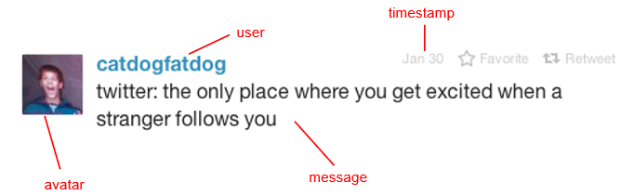
Anatomy of a tweet
What is in a tweet???
Is that all there is???

Slide 3
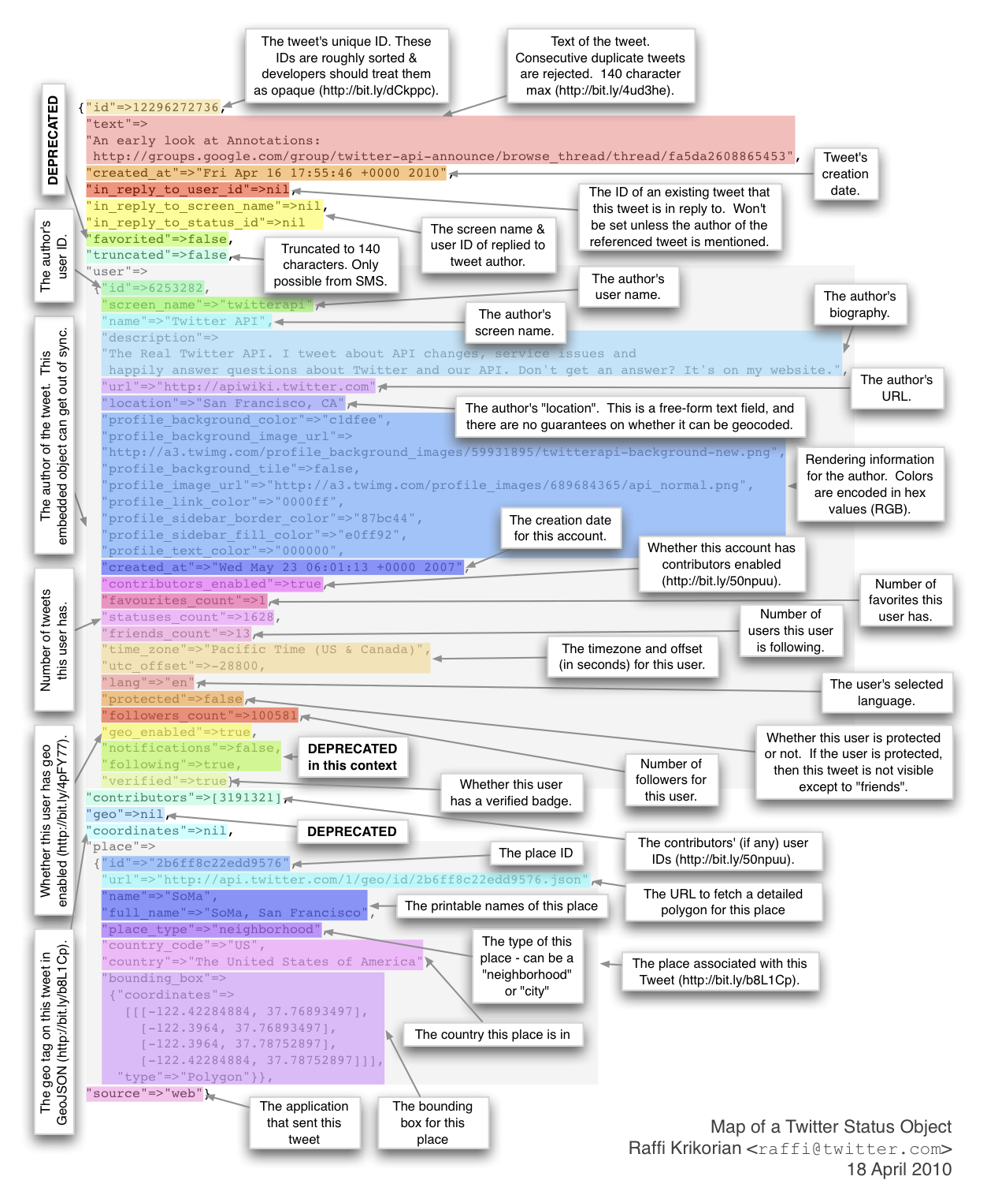
A lot more than that….

Slide 4


How do we get tweets???
Streaming API:
Subscribe to real-time feeds moving forward
REST Search API:
Search request on past data (1 week)

Slide 5
Our Project??
Fetched Tweets using Twitter Streaming API
Computed the term frequency
Used sentimental analysis to find Happiest State in US and Happiest Actor in Breaking Bad TV Series.

Slide 6
Calculating Term Frequency
Formula:
# of occurrences of the term in all tweets
Number of occurrences of all terms in all tweets
Results in the form:
[term] [Frequency]

Slide 7
Results

Slide 8
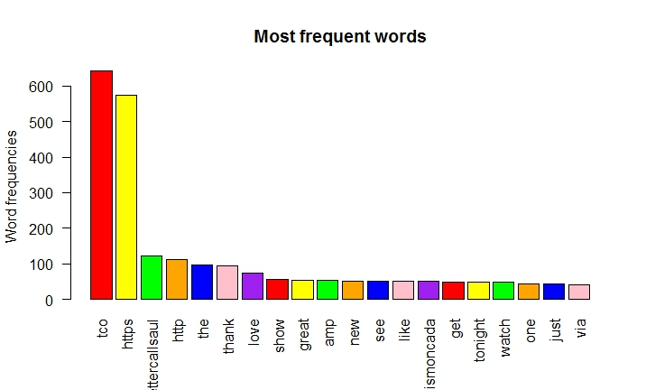

Slide 9
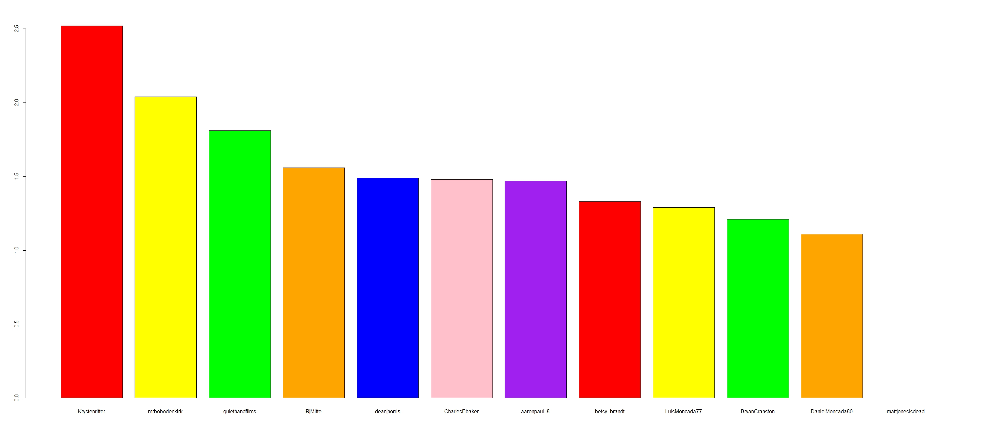
Happiest Actors

Slide 10
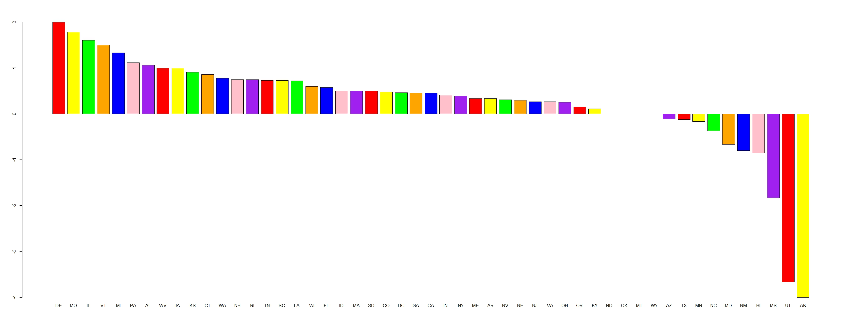
Happiest and Unhappiest States

